Slide 1



Bowtielearning Music school
Music for everyone

Slide 2
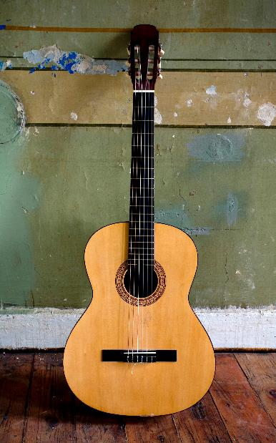
Favorite Instruments
Guitars
Pianos
Drums

Slide 3
Popular Styles

Slide 4
Business Performance
PERFORMANCE
Year
Values
$ 3,577
$ 1,672,054
2018
- 3.567%
2019
+ 1.007%
Value Per Capita
2020
+ 2.012%
Market Value
2021
+ 4,031%
INCOME PERCENTAGE
Music is good business
75%

Slide 5

Soundscapes
SELECTION
QUALITY
EQUIPMENT
SOUND

Slide 6

Contact US
info@Bowtielearning.com

